Slide 1
SJSU CS 46A Introduction to Programming
Notes:
Sections 1.1 – 1.6
Welcome to SJSU!
Welcome to CS 46A!

Slide 2
Instructor
Qi Yang
SJSU Home Page (click here)
Office Hour (online): TR 8:00 – 8:50 pm
Email: qi.yang@sjsu.edu
Notes:
Sections 1.1 – 1.6
282 Duncan Hall

Slide 3
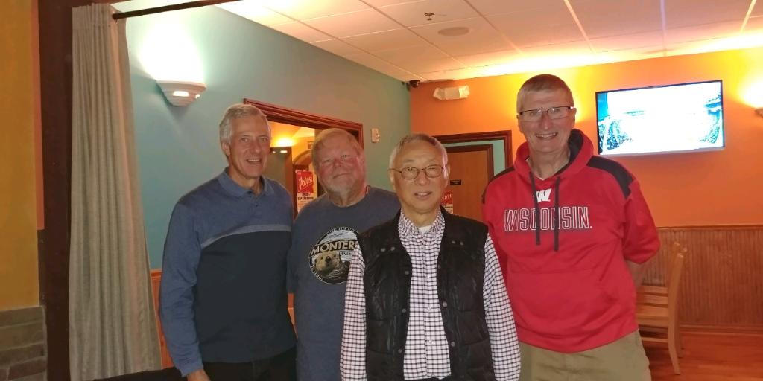
University of Wisconsin - Platteville
Notes:
Professor Emeritus, Computer Science

Slide 4
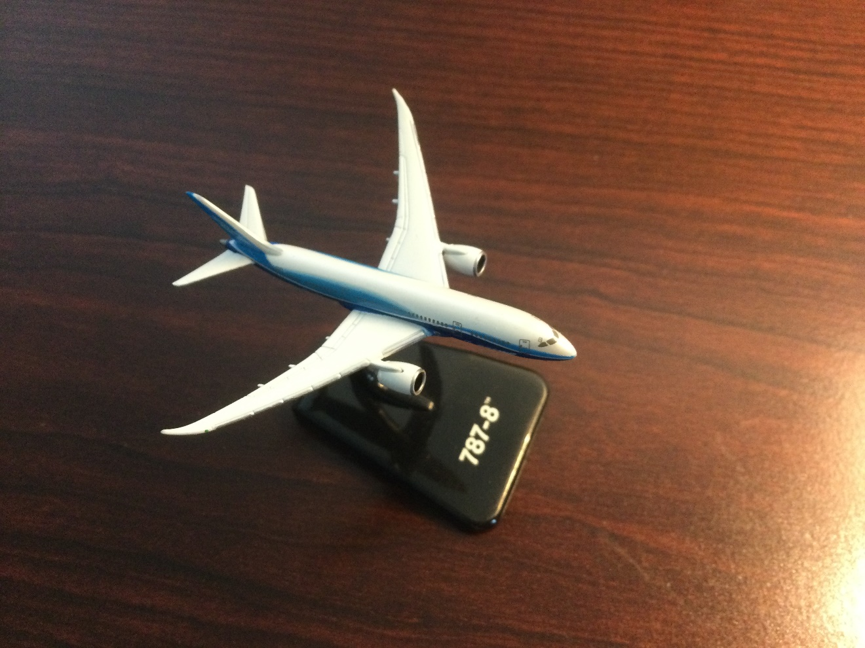
AVISTA (Link)

Slide 5
Supplemental Instruction Leaders
Mathew Chan
Nachiketh Mamidi
Attending our classes
Holding SI sessions every week
SJSU Peer Connection

Slide 6
Student Lab Instructors
Lab 11: 7:30AM - 10:15AM, Viola Yasuda
Lab 12: 11:00AM - 1:45PM, An-Chieh Cheng
Lab 13: 2:00PM - 4:45PM, Pranav Ghaskadbi
Lab 14: 7:30AM - 10:15AM, Tanisha Damle
Lab 15: 11:00AM - 1:45PM, Manomaysubban
Narasimha
Lab 16: 2:00PM - 4:45PM, Bhagyesh Rathi

Slide 7
Graders
Dao Seckar
Cuong Pham
Khushi Chandra
Participation exercises
Homework

Slide 8
Student Tutors (CSSL)
Free services provided by the department
Starting in week 3
Computer Science Study Lab
Click here

Slide 9
Course Description
Basic skills and concepts of computer programming in an object-oriented approach using Java. Classes, methods and argument passing, control structures, iteration. Basic graphical user interface programming. Problem solving, class discovery and stepwise refinement. Programming and documentation style. Weekly hands-on activity.
Notes:
Skills and concepts

Slide 10
Course Description
Basic skills and concepts of computer programming in an object-oriented approach using Java. Classes, methods and argument passing, control structures, iteration. Basic graphical user interface programming. Problem solving, class discovery and stepwise refinement. Programming and documentation style. Weekly hands-on activity.

Slide 11
Course Description
Basic skills and concepts of computer programming in an object-oriented approach using Java. Classes, methods and argument passing, control structures, iteration. Basic graphical user interface programming. Problem solving, class discovery and stepwise refinement. Programming and documentation style. Weekly hands-on activity.

Slide 12
Students Learning Outcomes
Upon completion of this course, students should be able to:
Analyze and explain the behavior of programs involving the fundamental program constructs
Write short programs that use the fundamental program constructs including standard conditional and iterative control structures
Identify and correct syntax and logic errors in short programs
Choose arrays or array lists for a given problem and write short programs that use arrays or array lists
Design and implement a class based on attributes and behaviors of objects
Construct objects using a class and activate methods on them
Write Javadoc comments for classes and methods
Write graphics program that draws simple shapes
Use interfaces and inheritance to describe common behavior of classes and write programs that use that common behavior
Use an integrated development environment and a debugger

Slide 13
Canvas

Slide 14
Textbook
Big Java - Early Objects
FirstDay Program
Course Materials in Canvas
Can opt out by 09-02-2022

Slide 15
Pre-Class Work
Reading textbook
Doing self-check quizzes

Slide 16
In-Class iClicker Questions (5%)
iClicker account
Receiving one point for answering each question, no matter correct or not
No iClicker questions today
The scores for Lesson01 and Lesson02 will be ignored (after exam1)
The lowest score of the rest will be dropped
Notes:
Sync Roster
No questions

Slide 17
Participation Exercises (5%)
Two programs each lecture
Answers at the end of the next class
Due time: 6 pm of the next class day
Grace time: 8 pm of the next class day
Par01 and Par02 will be ignored (after exam1)
The lowest score of the rest will be dropped

Slide 18
Weekly Labs (10%)
Fridays, In-Person
Reinforcing what you learn in class
Helping do the homework and other course work
Lab Rules in Canvas
Missing more than three labs will fail the Lab and CS 46A
No make ups
The lowest three scores will be dropped

Slide 19
Weekly Homework (20%)
Individual work
Asking for help is encouraged
Make sure you know how to do similar problems in the future (on exams)
The lowest score will be dropped

Slide 20
Exams (60%)
Exam1: October 06, 15%
Exam2: November 15, 15%
Final Exam: December 14, 30%

Slide 21
Course Work
Pre-class Work --
In-Class iClicker Questions 5%
Participation Exercises 5%
Weekly Labs 10%
Weekly Homework 20%
2 Midterm Exams 30%
Final Exam 30%
--------------------------------------
Total 100%

Slide 22
Grading
Grade Percentage Grade Points
A 93% 4.0
A - 90% 3.7
B + 87% 3.3
B 83% 3.0
B - 80% 2.7
C + 77% 2.3
C 73% 2.0
C - 70% 1.7
D + 67% 1.3
D 63% 1.0
D - 60% 0.7
F Below 60% 0.0
No Extra Work
No Curve
89.9% is B+, not A-

Slide 23
Due Time and Grace Time
Late Submissions (after due time)
Pars and Labs: -2
Homework: -5
Exams: -5
Rejected Submissions (after grace time)
No credit and no make up

Slide 24
Course Mechanics
Required Laptop
Windows/Mac/Linux
Codecheck Websites
Participation exercises
Homework
Exam1, Exam2, and Final Exam
Canvas
All materials
All submissions
All scores

Slide 25
CS 46A (CS I at SJSU)
DFW Rate: 20 – 30%

Slide 26
Qi’s First Five Semesters at SJSU
Semester | Number of Students | DFW Students (< 70%) |  | A Students (>= 90%)
 |  | Count | Percentage | Count | Percentage
Spring 2020 | 151 | 42 | 27.8% | 26 | 17.2%
Fall 2020 | 161 | 30 | 18.6% | 67 | 41.6%
Spring 2021 | 114 | 27 | 22.7% | 46 | 40.3%
Fall 2021 | 173 | 33 | 19.1% | 72 | 41.6%
Spring 2022 | 154 | 30 | 19.5% | 63 | 40.9%

Slide 27
Qi’s Goal for CS 46A
Not too difficult to pass
Not too easy to get an A

Slide 28
Not Too Difficult to Pass
Exams: 60%
Others: 40%
60%
85%
0.6 * 0.6: 0.36
0.4 * 0.85: 0.34
Total:70% (0.7)
Grade: C-

Slide 29
Not Too Easy to Get an A
One tough problem on each exam!
Style

Slide 30
Prior Programming Experience?

Slide 31
Fall 2020: 30 DFW Students
Prior Programming Experience | Total # of Students | # of Students (< 70%) | Percentage
0 | 35 | 12 | 34.3%
1 | 32 | 5 | 15.6%
2 | 45 | 8 | 17.7%
3 | 35 | 2 | 5.7%
4 | 12 | 1 | 8.3%
No answers |  | 2

Slide 32
Fall 2020
Class Ranking | Total Points Percentage | Prior Programming Experience
1 | 99.95% | 0
2 | 99.70% | 3
3 | 99.57% | 3
4 | 99.31% | 4
5 | 99.26% | 1

Slide 33
Fall 2020
Prior Programming Experience: 5
8 Students
Course Grade | Number of Students
A | 5
B | 2
C | 1

Slide 34
What Should I Do?
Take CS 22A (click here) this semester
Take CS 46A next semester
Take CS 46A this semester
Drop by Sept 15
Take CS 46A again if failed
Take CS 46B next semester

Slide 35
Taking CS 46A This Semester
Good Luck!
Work Hard
Start Homework Early
Follow Instructions

Slide 36
Software: Programs
What is a Computer Program?
A sequence of instructions and decisions.
What is Computer Programming?
The act of designing and implementing computer programs.
Computer Programming Languages
High Level Programming Language
Low Level Programming Language

Slide 37
Steps of Computer Programming
Understanding the problem
Developing an algorithm (pseudocode)
Creating source code (text files)
Compiling
Converting high-level language code to low-level language code
Running and debugging the program

Slide 38
Integrated Development Environment IDE
IDE
Creating source code (text files)
Compiling
Debugging the program
BlueJ
NetBeans
Eclipse

Slide 39
Low Level Programming Languages
Machine Code
10010110 00000000 10100101
Assembly Code
Add AX, Score

Slide 40
High Level Programming Languages
C++, Java, Python . . .
English Like
Easy to Read and Write
(Compared with low level languages)
Java Code Example
total = total + 3;

Slide 41
Semantics, Syntax, and Style
Semantics: The meaning of the statement
total = total + 3;
Syntax: Language grammar
total = total + 3
Style: Code Format
total=total+3;
Notes:
“=” does not mean equals, but assignment
Missing semicolon!
Must follow, will not work otherwise
One space between any two tokens
In the course description and learning outcomes

Slide 42
Tasks
FirstWeekAttendance
Required
You might be dropped out if not completed
iClicker account
Lesson01 Pre-class work

Slide 43
Questions?

